Slide 1
NYC Crime Statistics
Instructor: Michael O’Donnell
Group 12
Sihan Lin, Jie Qu,
Jordan Wong, Xiaodie Zhao

Slide 2
Agenda
Goals
KIPs
Conclusion

Slide 3
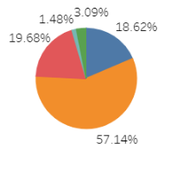
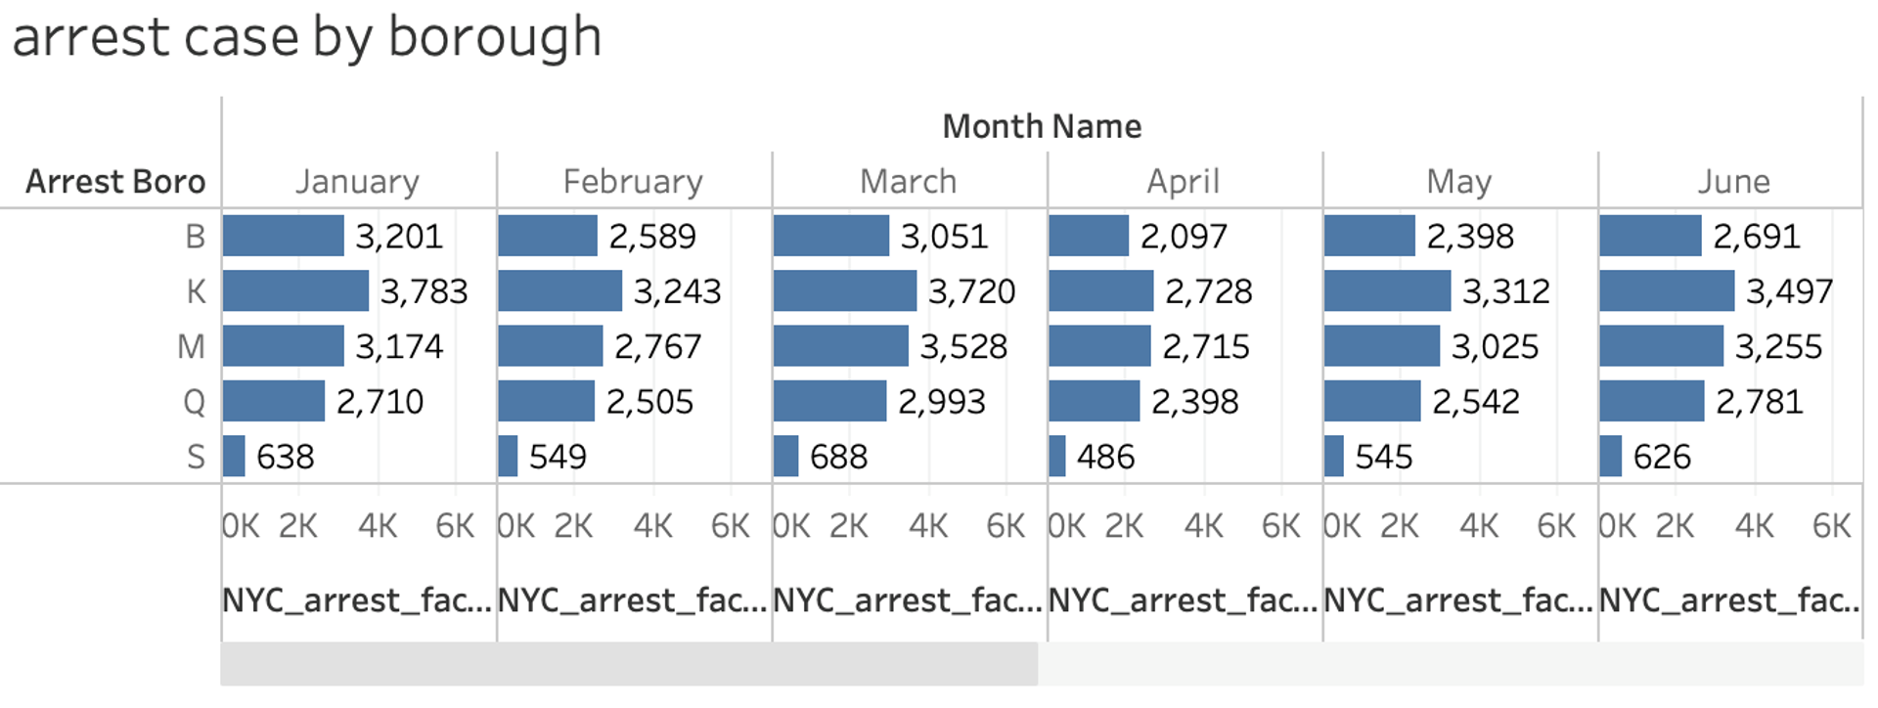
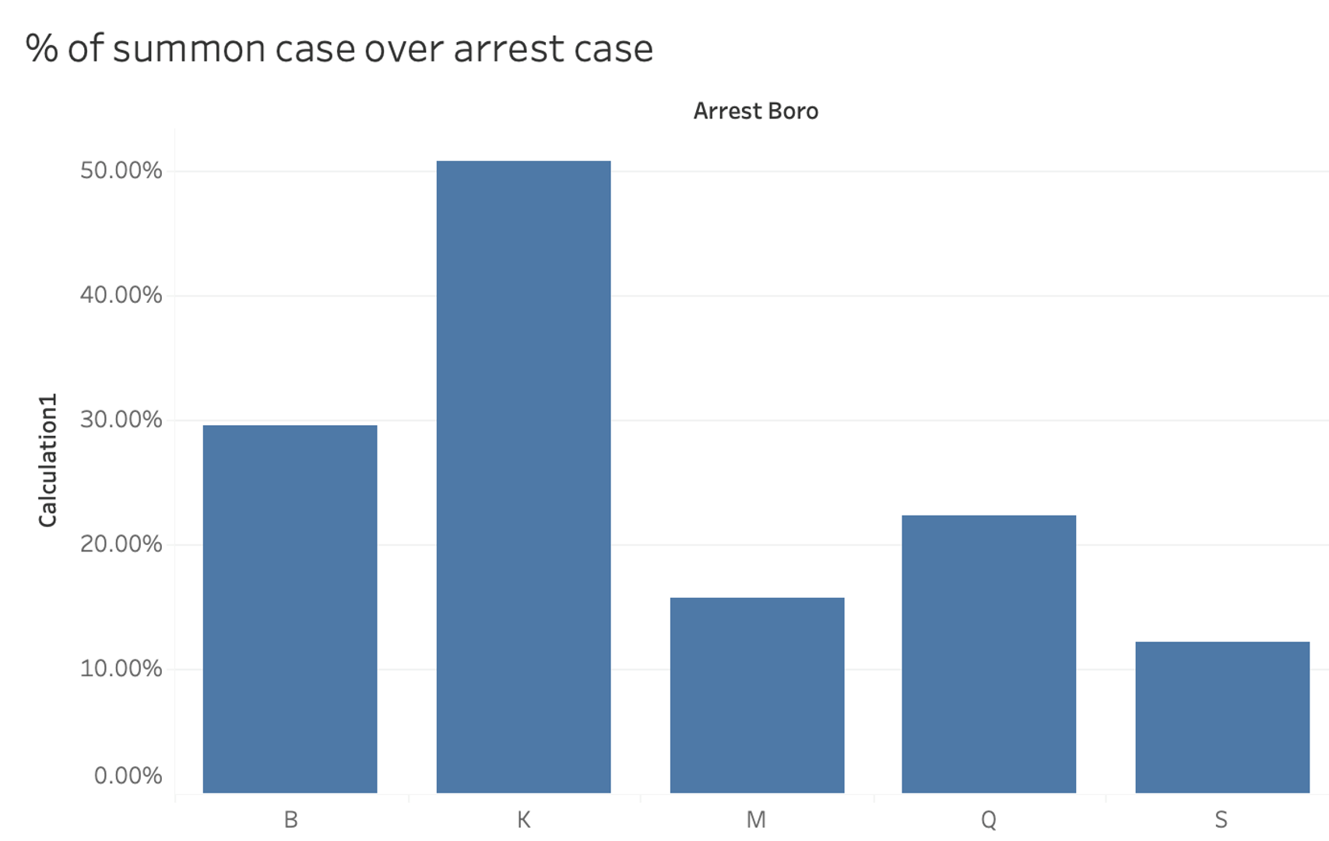

Goals
Provide a transparency report to the public
Better allocate limited resource

Slide 4
Monthly Arrest Cases by Borough
B = Bronx
K = Brooklyn
M = Manhattan
Q = Queens
S = Staten Island

Slide 5
Monthly Arrest Cases By Age Group
&
Percentage of Arrest Cases Over Criminal Court Cases By borough

Slide 6
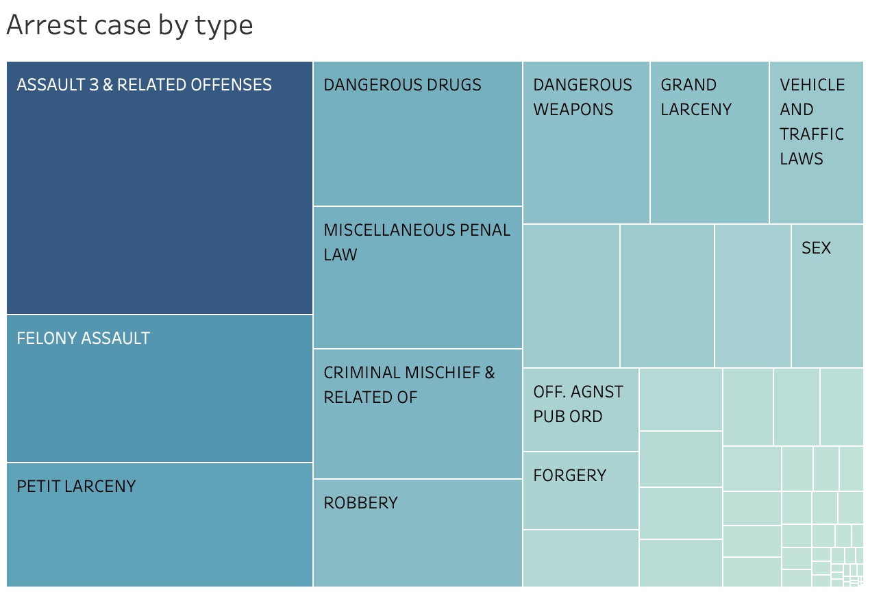
点击添加标题
05
点击添加标题
The darker and bigger the square,
the higher the number of crimes

Slide 7
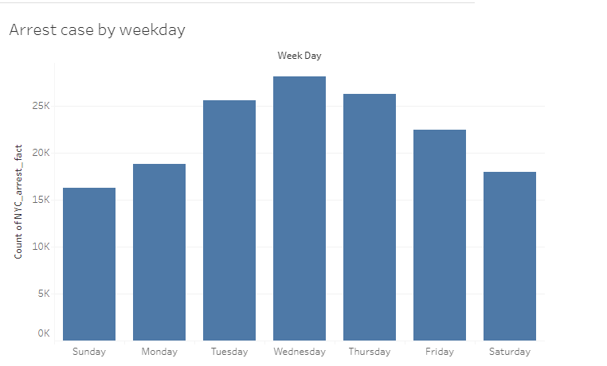
点击添加标题
05
点击添加标题

Slide 8





Looking Forward
Why do more arrest cases happened on Wednesday?
Should NYPD increase police resources in Brooklyn and Manhattan?
Why Brooklyn had more arrest case go to court than Manhattan and Staten Island?

Slide 9
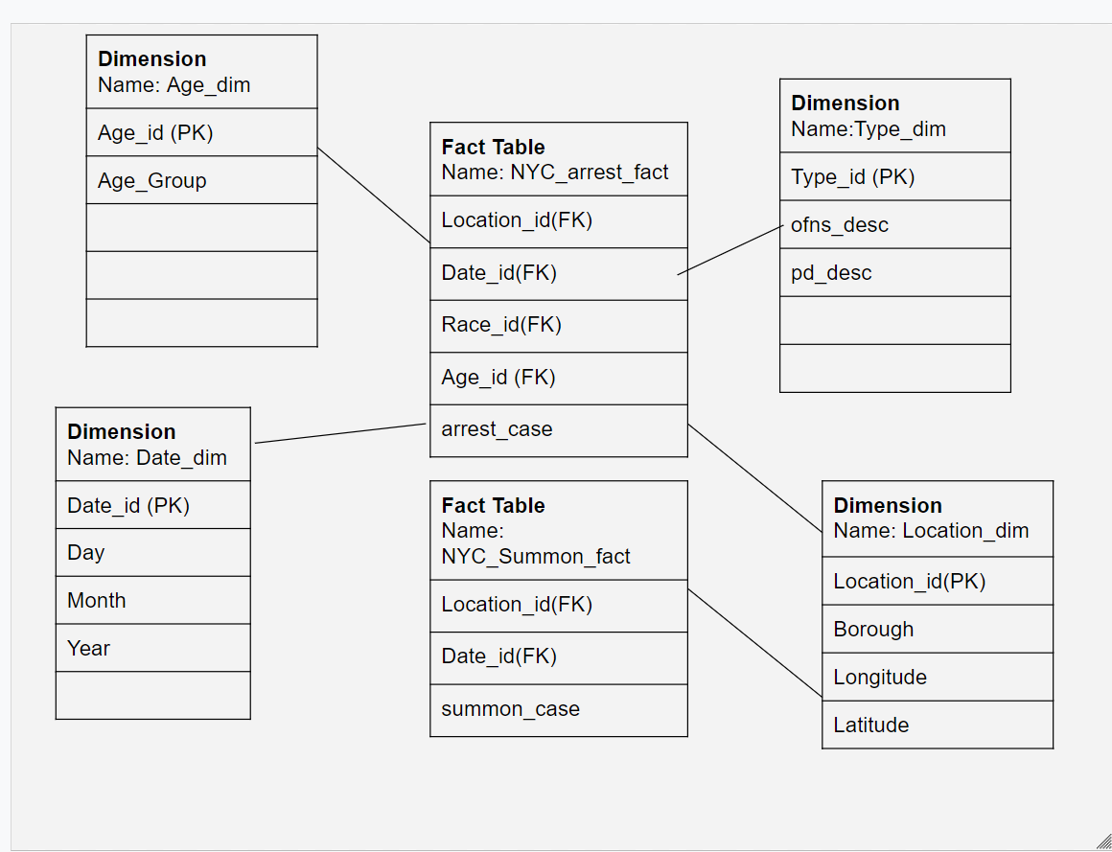
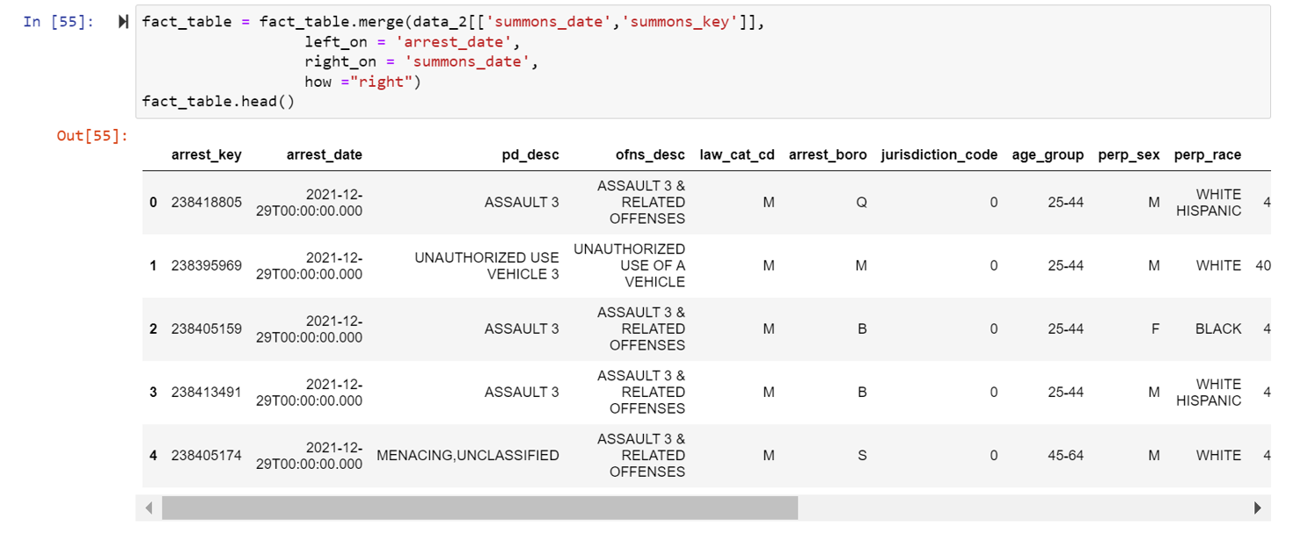
What is the difficulty of the project?

Slide 10

Q&A

